Slide 1
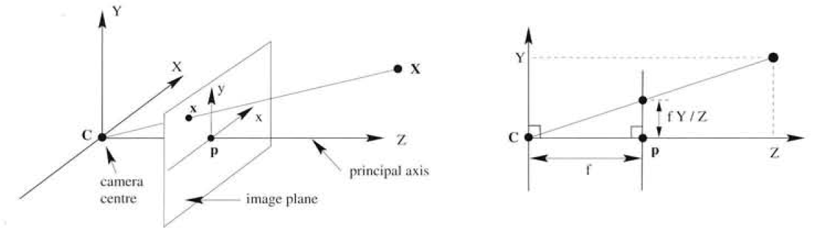
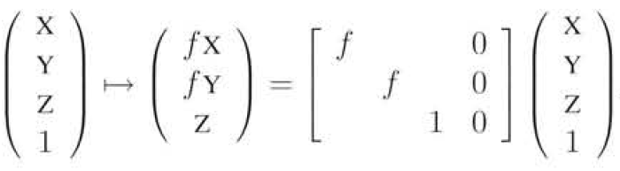
Camera Geometry (MVG Ch - 6)
All Images Courtesy: Hartley & Zisserman
Image point: Intersection of 3-D line(joining C and word point) and the image plane
Let a point in space be :
Parametric eq. of line
The Line joining the point and Camera Center C is :
Image Plane

Slide 2
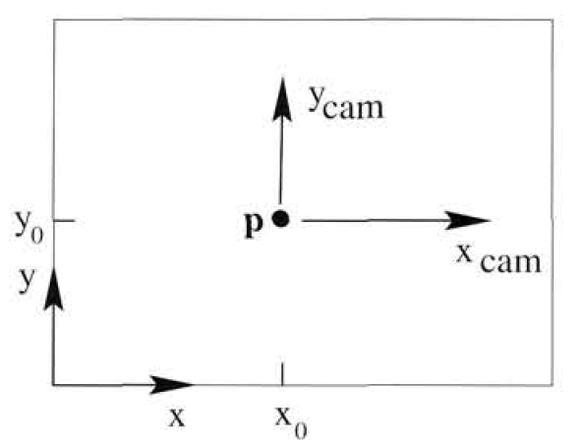
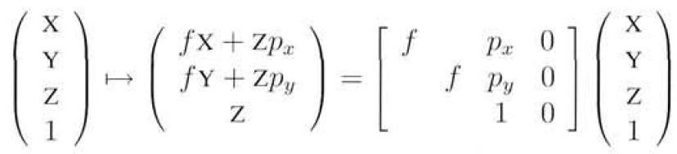
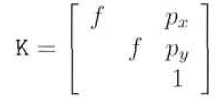

Principal Point Offset
What if the origin of the image plane is not principal point? The model assumes it! The generalized formulation for an arbitrary choice of image origin is given below:

Slide 3
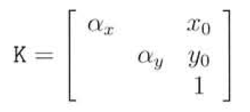
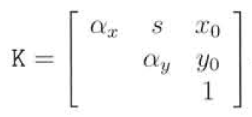


Pixel Coordinates
Let the number of pixels per unit distance in image coordinates are and in x and y directions respectively,
then the world coordinates to pixel coordinates mapping is given below
Camera Calibration Matrix

Slide 4
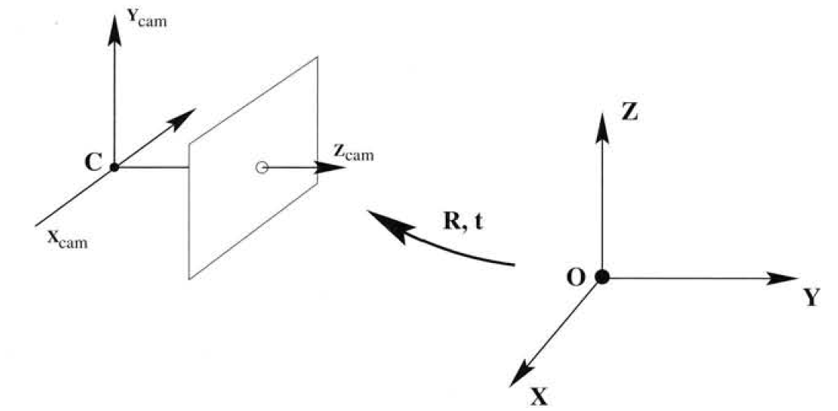
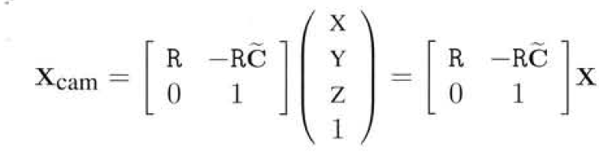



Camera Orientation and Position
What if Camera frame and World frame are different?

Slide 5
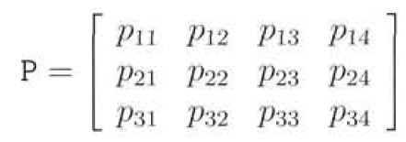

Projective Camera
P is Projective Camera if Rank(P) = 3
If Rank(M) = 3 then camera is finite, i.e.
the camera center is not at infinity
If Rank(M) = 2 then the camera centre is
at infinity, (Camera at infinity)

Slide 6
Camera Centre
Consider the set of points along the Line joining some point A and the Camera Center C :
All such points will map to the same image point PA
Camera can image every point in 3-D but it’s own centre! Why?
So with respect to imaging, the camera centre is a unique point in space
If Rank(M) = 2, then C will be a point at infinity, i.e. the last coordinate of C will be zero! (Camera at infinity!)

Slide 7
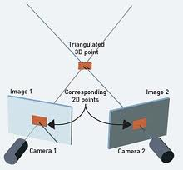


3-D Reconstruction: Triangulation
Assumptions
Camera Matrices are known
Image correspondences are known
The intersection of both the 3-D lines is the 3-D point X
What if camera matrix is not known?

Slide 8
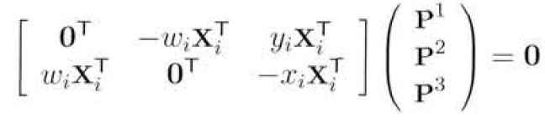
Estimating Camera Matrix and Calibration Matrix
DLT

Slide 9
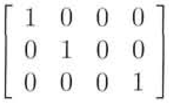
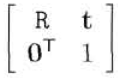
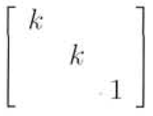
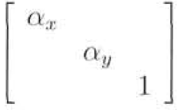
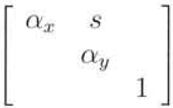
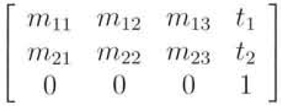
Cameras at Infinity
Orthographic Camera
Scaled Orthographic Camera
Weak Perspective Camera
Affine Camera
What is the form of Camera at infinity which is not Affine?

